Slide 1
Capital Structure

Slide 2
Capital Structure
Capital structure is the composition of a company’s sources of funds, a mix of owner’s capital (equity) and loan (debt) from outsiders.
It is used to finance its overall operations and investment activities.
An optimal capital structure comprises of enough balance between equity and debt.
Debt for an organization includes all short-term and long-term loans that the company has to repay.
Equity is the combination of common and preferred shares and their retained earnings.

Slide 3
Conti…
The source and quantum of capital is decided keeping in mind following factors:
Control: capital structure should be designed in such a manner that existing shareholders continue to hold majority stack.
Risk: capital structure should be designed in such a manner that financial risk of the company does not increases beyond tolerable limit.
Cost: overall cost of capital remains minimum.
Practically it is difficult to achieve all of the above three goals together hence a finance manager has to make a balance among these three objectives.

Slide 4











Financing Decision Process

Slide 5
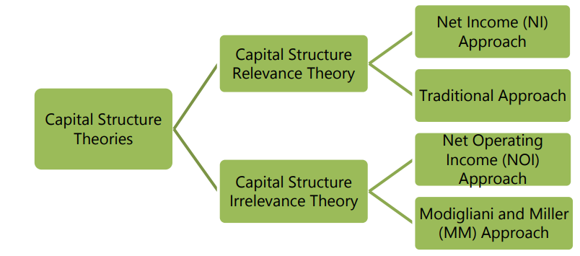
Capital structure theories
The following approaches explain the relationship between cost of capital, capital structure and value of the firm:

Slide 6
Net Income Approach (NI)
According to this approach, capital structure decision is relevant to the value of the firm.
An increase in financial leverage will lead to decline in the weighted average cost of capital (WACC), while the value of the firm as well as market price of ordinary share will increase.
Conversely, a decrease in the leverage will cause an increase in the overall cost of capital and a consequent decline in the value as well as market price of equity shares.

Slide 7
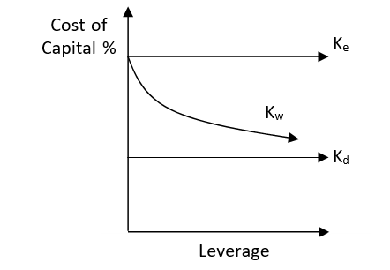
Conti…

Slide 8
Conti…
The value of the firm on the basis of Net Income Approach can be ascertained as follows:
Where,
V = Value of the firm, S = value of equity , D =value of debt
Where,
NI = Earnings available for equity shareholders Ke = Equity Capitalisation rate

Slide 9

Conti…
Under, NI approach, the value of the firm will be maximum at a point where weighted average cost of capital (WACC) is minimum. Thus, the theory suggests total or maximum possible debt financing for minimising the cost of capital. The overall cost of capital under this approach is:

Slide 10
Example
Rupa Ltd.’s EBIT is ` 5,00,000. The company has 10%,` 20 lakh debentures. The equity capitalization rate i.e. Ke is 16%.
You are required to CALCULATE:
(i) Market value of equity and value of firm
(ii) Overall cost of capital.

Slide 11
2. Traditional Approach
This approach favors that as a result of financial leverage up to some point, cost of capital comes down and value of firm increases.
However, beyond that point, reverse trends emerge.
The principle implication of this approach is that the cost of capital is dependent on the capital structure and there is an optimal capital structure which minimizes cost of capital.

Slide 12
Conti…
Under this approach:
The rate of interest on debt remains constant for a certain period and thereafter with an increase in leverage, it increases.
The expected rate by equity shareholders remains constant or increase gradually. After that, the equity shareholders starts perceiving a financial risk and then from the optimal point and the expected rate increases speedily.
As a result of the activity of rate of interest and expected rate of return, the WACC first decreases and then increases. The lowest point on the curve is optimal capital structure.

Slide 13
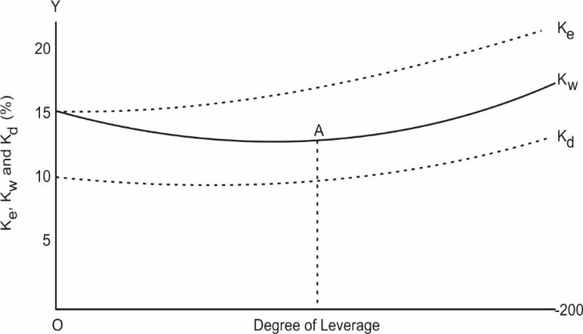
Conti…
Optimum capital structure occurs at the point where value of the firm is highest and the cost of capital is the lowest.

Slide 14
Net Operating Income Approach (NOI)
NOI means earnings before interest and tax (EBIT). According to this approach, capital structure decisions of the firm are irrelevant.
Any change in the leverage will not lead to any change in the total value of the firm and the market price of shares.
The Net Operating Income (NOI) approach is opposite to the NI approach. According to the NOI approach, the market value of the firm depends upon the net operating profit or EBIT and the overall coat of capital, WACC. The financing mix or the capital structure is irrelevant and does not affect the value of the firm.

Slide 15
Conti…
The NOI approach makes the following assumptions:
The investors see the firm as a whole and thus capitalizes the total earning of the firm to find the value of the firm as a whole.
The overall cost of capital ,WACC, of the firm is constant and depends upon the business risk which is assumed to be unchanged.
The cost of debt, kd, is also taken as constant.
That there is no tax.

Slide 16
Conti…
V = EBIT / k o
And E = V - D
And the cost of equity capital, ke , is
ke = EBIT - Int. / V- D

Slide 17
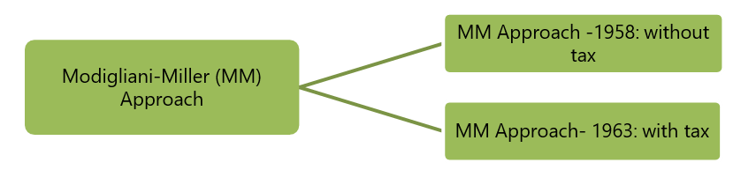
Modigliani-Miller Approach (MM)
Modigliani-Miller approach provides behavioural justification for constant overall cost of capital and therefore, total value of the firm.

Slide 18
Conti….
This approach describes, in a perfect capital market where there is no transaction cost and no taxes, the value and cost of capital of a company remain unchanged irrespective of change in the capital structure. The approach is based on further additional assumptions like:
Capital markets are perfect. All information is freely available and there are no transaction costs.
All investors are rational.
Firms can be grouped into ‘Equivalent risk classes’ on the basis of their business risk.
Non-existence of corporate taxes.

Slide 19
Conti…
Based on the above assumptions, Modigliani-Miller derived the following three propositions:
Total market value of a firm is equal to its expected net operating income divided by the discount rate appropriate to its risk class decided by the market.
Value of levered firm (Vg) = Value of unlevered firm (Vu)

Slide 20
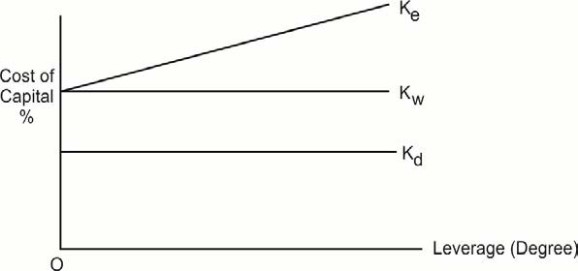
Proposition-I

Slide 21
MM Approach- 1963: with tax Proposition -II
In 1963, MM model was amended by incorporating tax, they recognised that the value of the firm will increase, or cost of capital will decrease where corporate taxes exist.
As a result, there will be some difference in the earnings of equity and debt- holders in levered and unlevered firm and value of levered firm will be greater than the value of unlevered firm by an amount equal to amount of debt multiplied by corporate tax rate.

Slide 22
Optimal Capital Structure (EBIT-EPS Analysis)
The basic objective of financial management is to design an appropriate capital structure which can provide the highest earnings per share (EPS) over the firm’s expected range of earnings before interest and taxes (EBIT).

Slide 23
EBIT-EPS-MPS Analysis
Relationship between EBIT - EPS-MPS
The basic objective of financial management is to design an appropriate capital structure which can provide the highest wealth, i.e., highest MPS, which in turn depends on EPS.
Given a level of EBIT, EPS will be different under different financing mix depending upon the extent of debt financing.

Slide 24
Conti….
The effect of leverage on the EPS emerges because of the existence of fixed financial charge i.e., interest on debt financial fixed dividend on preference share capital.
If the rate of return on assets is higher than the cost of financing, then the increasing use of fixed charge financing (i.e., debt and preference share capital) will result in increase in the EPS. This situation is also known as favourable financial leverage or Trading on Equity.
On the other hand, if the rate of return on assets is less than the cost of financing, then the effect may be negative and, therefore, the increasing use of debt and preference share capital may reduce the EPS of the firm

Slide 25
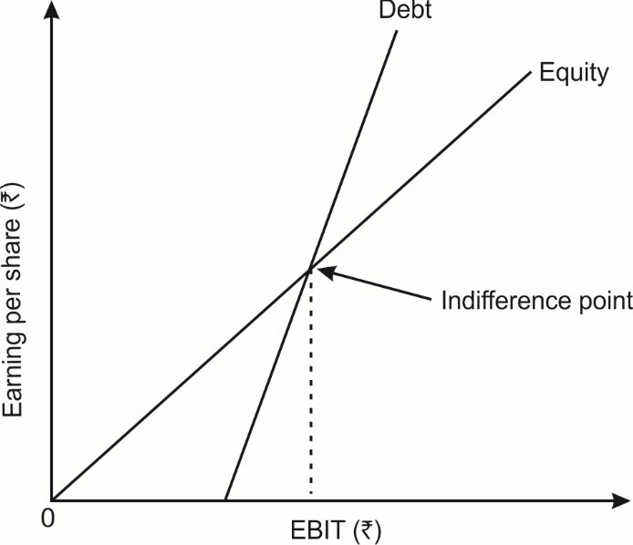
Financial Break-even and Indifference Analysis

Slide 26

Conti….
The equivalency or indifference point can also be calculated algebraically in the following manner:
Where,
EBIT = Indifference point
E1 = Number of equity shares in Alternative 1
E2 = Number of equity shares in Alternative 2
I1 = Interest charges in Alternative 1
I2 = Interest charges in Alternative 2
T = Tax-rate

Slide 27
Example
A company's present capital structure consists of 3,000 equity shares and 1,00 preferences shares. The firm's current PBIT is Rs.14400. Preference shares carry a dividend of Rs.12 per share. The earnings per share is Rs.2. The firm is planning to raise Rs.20000 of external financing. Two financing alternatives are being considered: (i) issuing 2,000 equity shares for Rs.10 each, (ii) issuing debentures for Rs.20000 carrying 15 percent interest.
Required
(a) Compute the EPS-PBIT indifference point.
(b) Define the alternative which maximises EPS for various levels of PBIT.

Slide 28
Example
PQR company's present capital structure consists of 2,000 shares of equity stock. It requires Rs.20000 of external financing for which it is considering three alternatives. Alternative A calls for issuing 2,000 equity shares (Rs.10 par); alternative B calls for issuing 1,200 equity shares (Rs.10 par) and 8,00 preference shares (Rs.10 par) carrying 11 percent dividend; alternative C calls for issuing 4,00 equity shares (Rs.10 par) and Rs.16000 of debentures carrying 15 percent interest. The company's tax rate is 50 percent.
Required:
a. What is the EPS-EBIT equation for alternative A,B and C?
b. Rank the alternative according to EPS over varying levels of EBIT i.e. Rs.30,00 and 50,00

Slide 29
Example
Blueline software Ltd. has appointed you as finance manager. The company wants to implement a project for expansion for which Rs. 20 lakhs (2 million) are required to be raised from the market. The company has an objective of maximising earning per share. The following three feasible financial plans are available:
(i) The company may issue 2 lakh equity shares of Rs. 10 each.
(ii) The company may issue 1,00,000 equity shares of Rs. 10 per share and 10,000 debentures of Rs. 100 denominations bearing 8% rate of interest.
(iii) The company may issue 1,00,000 equity shares of Rs. 10 per share and 10,000 preference shares at Rs. 100 per share carrying an 7% rate of dividend.
The expansion is expected to yield an annual EBIT of Rs. 3,20,000.
Assume a tax rate of 30%. Determine the EPS for three financing alternatives.

Slide 30
Example
Shahji Steels Limited requires ` 25,00,000 for a new plant. This plant is expected to yield earnings before interest and taxes of ` 5,00,000. While deciding about the financial plan, the company considers the objective of maximizing earnings per share. It has three alternatives to finance the project - by raising debt of ` 2,50,000 or ` 10,00,000or ` 15,00,000 and the balance, in each case, by issuing equity shares. The company's share is currently selling at ` 150, but is expected to decline to ` 125 in case the funds are borrowed in excess of ` 10,00,000. The funds can be borrowed at the rate of 10 percent upto ` 2,50,000, at 15 percent over ` 2,50,000 and upto ` 10,00,000 and at 20 percent over ` 10,00,000. The tax rate applicable to the company is 50 percent.
ANALYSE which form of financing should the company choose?

